Slide 1


Power Trading Forecasting Analysis

Slide 2

Contents
Business Objective
Business Constraints
Project Architecture - Data Flow Diagram
Data Collection
Exploratory Data Analysis
Data Visualization
Notes:
Change

Slide 3


Business Problem
In the power trading industry, market participants face major challenges due to fluctuating electricity prices, unpredictable demand-supply conditions, and rapidly changing market dynamics. These uncertainties increase financial risk and make it difficult to maximize profitability and operational efficiency.
The key challenge is to integrate multiple real-time and historical data sources — such as power demand, generation capacity, weather conditions, fuel prices, and market prices — to make accurate trading decisions. Additionally, traders must manage market volatility, forecast price movements, and optimize trading strategies in real time while minimizing risk exposure.
An efficient data-driven solution is required to improve forecasting accuracy, enable smarter trading decisions, reduce financial losses, and enhance overall market performance.

Slide 4
Project Overview and Scope
This project focuses on developing a data-driven power trading optimization solution for a leading power and infrastructure provider. The objective is to reduce financial risks caused by electricity price volatility and demand-supply fluctuations while improving trading efficiency and profitability.
The solution integrates multiple data sources such as historical power prices, real-time market data, weather conditions, energy demand, and generation capacity to enable accurate forecasting and intelligent decision-making. Advanced analytics and predictive modeling techniques are used to identify market trends, forecast price movements, and optimize trading strategies in real time.
The project aims to help traders and utility companies minimize procurement costs, maximize trading returns, and improve operational efficiency through better risk management and data-driven insights. The expected outcome includes reduced financial exposure, optimized energy procurement, and improved profitability in power trading operations.

Slide 5
Data Dictionary
Name Of Columns | Description | Data Type | Range | Scale Of Mesurement | Relevent / Irrelevent
Date | Trading date of the electricity market data | datetime | 0 | Datetime | Irrelevent
Hour | Hour of the day (1–24) representing the trading interval | int | 1 to 24 | Unitless | Relevent
Time Block | Discrete time block identifier used in electricity market scheduling | datetime | 0 | Unitless | Irrelevent
Purchase Bid (MW) | Total electricity demand bids submitted by buyers | float | 2590.4 to 43860.3 | MW | Relevent
Sell Bid (MW) | Total electricity supply offers submitted by sellers | float | 762.5 to 63406.7 | MW | Relevent
MCV (MW) | Market Clearing Volume determined after matching supply and demand | float | 762.47 to 16270.27 | MW | Relevent
Final Scheduled Volume (MW) | Final electricity volume scheduled for delivery after market clearing | float | 762.47 to 16270.27 | MW | Relevent
MCP (Rs/MWh) * | Market Clearing Price of electricity | float | 49.51 to 12000.0 | Rs. | Relevent
time | Timestamp corresponding to the observation in datetime format | datetime | 0 | Datetime | Irrelevent
Mundra_temperature_2m (°C) | Ambient air temperature at 2 meters above ground level | float | 9.6 to 40.2 | °C | Relevent
Mundra_relative_humidity_2m (%) | Relative humidity at 2 meters above ground level | int | 6 to 99 | % | Relevent
Mundra_cloud_cover (%) | Percentage of sky covered by clouds | int | 0 to 100 | % | Relevent
Mundra_wind_speed_10m (km/h) | Wind speed measured at 10 meters above ground level | float | 0.0 to 82.5 | km/h | Relevent
Mundra_shortwave_radiation (W/m²) | Incoming solar shortwave radiation at surface level | int | 0 to 1017 | W/m² | Relevent
RamaGundem_temperature_2m (°C) | Ambient air temperature at 2 meters above ground level | float | 12.4 to 42.8 | °C | Relevent
RamaGundem_relative_humidity_2m (%) | Relative humidity at 2 meters above ground level | int | 10 to 100 | % | Relevent
RamaGundem_cloud_cover (%) | Percentage of sky covered by clouds | int | 0 to 100 | % | Relevent
RamaGundem_wind_speed_10m (km/h) | Wind speed measured at 10 meters above ground level | float | 0.0 to 33.4 | km/h | Relevent
RamaGundem_shortwave_radiation (W/m²) | Incoming solar shortwave radiation at surface level | int | 0 to 982 | W/m² | Relevent
Vindhyachal_temperature_2m (°C) | Ambient air temperature at 2 meters above ground level | float | 4.9 to 46.1 | °C | Relevent
Vindhyachal_relative_humidity_2m (%) | Relative humidity at 2 meters above ground level | int | 6 to 100 | % | Relevent
Vindhyachal_cloud_cover (%) | Percentage of sky covered by clouds | int | 0 to 100 | % | Relevent
Vindhyachal_wind_speed_10m (km/h) | Wind speed measured at 10 meters above ground level | float | 0.0 to 37.6 | km/h | Relevent

Slide 6
Data Dictionary
Vindhyachal_shortwave_radiation (W/m²) | Incoming solar shortwave radiation at surface level | int | 0 to 1001 | W/m² | Relevent
Bhadla_temperature_2m (°C) | Ambient air temperature at 2 meters above ground level | float | 2.0 to 49.8 | °C | Relevent
Bhadla_relative_humidity_2m (%) | Relative humidity at 2 meters above ground level | int | 3 to 100 | % | Relevent
Bhadla_cloud_cover (%) | Percentage of sky covered by clouds | int | 0 to 100 | % | Relevent
Bhadla_wind_speed_10m (km/h) | Wind speed measured at 10 meters above ground level | float | 0.0 to 47.5 | km/h | Relevent
Bhadla_shortwave_radiation (W/m²) | Incoming solar shortwave radiation at surface level | int | 0 to 961 | W/m² | Relevent
Akaltara_temperature_2m (°C) | Ambient air temperature at 2 meters above ground level | float | 10.1 to 46.7 | °C | Relevent
Akaltara_relative_humidity_2m (%) | Relative humidity at 2 meters above ground level | int | 7 to 100 | % | Relevent
Akaltara_cloud_cover (%) | Percentage of sky covered by clouds | int | 0 to 100 | % | Relevent
Akaltara_wind_speed_10m (km/h) | Wind speed measured at 10 meters above ground level | float | 0.0 to 33.4 | km/h | Relevent
Akaltara_shortwave_radiation (W/m²) | Incoming solar shortwave radiation at surface level | int | 0 to 995 | W/m² | Relevent
Khavda_temperature_2m (°C) | Ambient air temperature at 2 meters above ground level | float | 8.4 to 44.1 | °C | Relevent
Khavda_relative_humidity_2m (%) | Relative humidity at 2 meters above ground level | int | 5 to 100 | % | Relevent
Khavda_cloud_cover (%) | Percentage of sky covered by clouds | int | 0 to 100 | % | Relevent
Khavda_wind_speed_10m (km/h) | Wind speed measured at 10 meters above ground level | float | 0.0 to 77.2 | km/h | Relevent
Khavda_shortwave_radiation (W/m²) | Incoming solar shortwave radiation at surface level | int | 0 to 1033 | W/m² | Relevent
Muppandal_temperature_2m (°C) | Ambient air temperature at 2 meters above ground level | float | 19.4 to 40.5 | °C | Relevent
Muppandal_relative_humidity_2m (%) | Relative humidity at 2 meters above ground level | int | 17 to 100 | % | Relevent
Muppandal_cloud_cover (%) | Percentage of sky covered by clouds | int | 0 to 100 | % | Relevent
Muppandal_wind_speed_10m (km/h) | Wind speed measured at 10 meters above ground level | float | 0.0 to 37.2 | km/h | Relevent
Muppandal_shortwave_radiation (W/m²) | Incoming solar shortwave radiation at surface level | int | 0 to 1039 | W/m² | Relevent
Srisailam_temperature_2m (°C) | Ambient air temperature at 2 meters above ground level | float | 12.3 to 43.7 | °C | Relevent
Srisailam_relative_humidity_2m (%) | Relative humidity at 2 meters above ground level | int | 9 to 100 | % | Relevent
Srisailam_cloud_cover (%) | Percentage of sky covered by clouds | int | 0 to 100 | % | Relevent
Srisailam_wind_speed_10m (km/h) | Wind speed measured at 10 meters above ground level | float | 0.0 to 33.1 | km/h | Relevent

Slide 7
Data Dictionary
Srisailam_shortwave_radiation (W/m²) | Incoming solar shortwave radiation at surface level | int | 0 to 1000 | W/m² | Relevent
Tehri_temperature_2m (°C) | Ambient air temperature at 2 meters above ground level | float | 1.9 to 40.4 | °C | Relevent
Tehri_relative_humidity_2m (%) | Relative humidity at 2 meters above ground level | int | 8 to 100 | % | Relevent
Tehri_cloud_cover (%) | Percentage of sky covered by clouds | int | 0 to 100 | % | Relevent
Tehri_wind_speed_10m (km/h) | Wind speed measured at 10 meters above ground level | float | 0.0 to 18.4 | km/h | Relevent
Tehri_shortwave_radiation (W/m²) | Incoming solar shortwave radiation at surface level | int | 0 to 991 | W/m² | Relevent
Blr_temperature_2m (°C) | Ambient air temperature at 2 meters above ground level | float | 11.9 to 39.5 | °C | Relevent
Blr_relative_humidity_2m (%) | Relative humidity at 2 meters above ground level | int | 10 to 100 | % | Relevent
Blr_cloud_cover (%) | Percentage of sky covered by clouds | int | 0 to 100 | % | Relevent
Blr_wind_speed_10m (km/h) | Wind speed measured at 10 meters above ground level | float | 0.0 to 39.3 | km/h | Relevent
Blr_shortwave_radiation (W/m²) | Incoming solar shortwave radiation at surface level | int | 0 to 1044 | W/m² | Relevent
Chn_temperature_2m (°C) | Ambient air temperature at 2 meters above ground level | float | 18.2 to 41.0 | °C | Relevent
Chn_relative_humidity_2m (%) | Relative humidity at 2 meters above ground level | int | 22 to 100 | % | Relevent
Chn_cloud_cover (%) | Percentage of sky covered by clouds | int | 0 to 100 | % | Relevent
Chn_wind_speed_10m (km/h) | Wind speed measured at 10 meters above ground level | float | 0.0 to 50.1 | km/h | Relevent
Chn_shortwave_radiation (W/m²) | Incoming solar shortwave radiation at surface level | int | 0 to 1013 | W/m² | Relevent
Delhi_temperature_2m (°C) | Ambient air temperature at 2 meters above ground level | float | 2.4 to 46.2 | °C | Relevent
Delhi_relative_humidity_2m (%) | Relative humidity at 2 meters above ground level | int | 5 to 100 | % | Relevent
Delhi_cloud_cover (%) | Percentage of sky covered by clouds | int | 0 to 100 | % | Relevent
Delhi_wind_speed_10m (km/h) | Wind speed measured at 10 meters above ground level | float | 0.0 to 37.4 | km/h | Relevent
Delhi_shortwave_radiation (W/m²) | Incoming solar shortwave radiation at surface level | int | 0 to 944 | W/m² | Relevent
Hyd_temperature_2m (°C) | Ambient air temperature at 2 meters above ground level | float | 11.1 to 41.4 | °C | Relevent
Hyd_relative_humidity_2m (%) | Relative humidity at 2 meters above ground level | int | 10 to 100 | % | Relevent
Hyd_cloud_cover (%) | Percentage of sky covered by clouds | int | 0 to 100 | % | Relevent
Hyd_wind_speed_10m (km/h) | Wind speed measured at 10 meters above ground level | float | 0.0 to 34.2 | km/h | Relevent
Hyd_shortwave_radiation (W/m²) | Incoming solar shortwave radiation at surface level | int | 0 to 989 | W/m² | Relevent
Mumbai_temperature_2m (°C) | Ambient air temperature at 2 meters above ground level | float | 15.5 to 41.0 | °C | Relevent
Mumbai_relative_humidity_2m (%) | Relative humidity at 2 meters above ground level | int | 10 to 99 | % | Relevent
Mumbai_cloud_cover (%) | Percentage of sky covered by clouds | int | 0 to 100 | % | Relevent
Mumbai_wind_speed_10m (km/h) | Wind speed measured at 10 meters above ground level | float | 0.0 to 44.1 | km/h | Relevent
Mumbai_shortwave_radiation (W/m²) | Incoming solar shortwave radiation at surface level | int | 0 to 982 | W/m² | Relevent

Slide 8
Exploratory Data Analysis [EDA]
Statistical Insights
The analysis identified significant fluctuations in power market prices, indicating high market volatility during peak trading periods.
Demand and supply patterns showed strong variability across different time intervals and regions.
Correlation analysis revealed that higher electricity demand directly influenced increases in market prices.
Time-series analysis highlighted recurring peak consumption periods during industrial and business operating hours.
Outlier detection identified sudden price spikes caused by demand surges, supply shortages, and market instability.
Variance and standard deviation values indicated considerable dispersion in trading prices, reflecting unstable market conditions.
Seasonal and weather-based trends impacted both electricity demand and trading behavior.
Risk analysis visuals showed certain regions consistently experiencing higher trading risk exposure compared to others.
Business Insights
Real-time monitoring of market prices and demand patterns can help traders reduce financial losses and improve decision-making.
Predictive analytics enables better forecasting of electricity prices, allowing optimized buying and selling strategies.
Identifying peak demand periods helps organizations maximize trading profitability and manage procurement efficiently.
Early detection of abnormal market fluctuations supports proactive risk mitigation and reduces exposure to volatile conditions.
Region-wise risk analysis helps businesses allocate energy resources more effectively and improve operational planning.
Integrating multiple market and operational data sources improves trading accuracy and enhances market responsiveness.
Optimized trading strategies can reduce procurement costs, improve operational efficiency, and increase revenue generation.
Data-driven insights support smarter energy distribution, better risk management, and long-term strategic planning in power trading operations.
Notes:
EDA is used for seeing what the data can tell us before the modeling task.
Change

Slide 9
Data Preprocessing
Data Cleaning
Data cleaning was performed to improve data quality and ensure accurate analysis.
Removed duplicate records from the dataset
Handled missing/null values using suitable techniques
Corrected inconsistent and invalid entries
Standardized date, time, and categorical formats
Removed unnecessary columns and irrelevant records
Data Type Conversion
Data types were converted to ensure compatibility with analytical tools and models.
Converted date columns into datetime format
Changed numerical columns stored as text into integer/float types
Converted categorical variables into encoded formats where required
Standardized timestamp formats for time-series analysis
Notes:
Keep observations

Slide 10
Data Preprocessing
Outlier Detection & Treatment
Outliers were identified to reduce the impact of abnormal market values and fluctuations.
Techniques Used:
Box Plot Analysis
Interquartile Range (IQR) Method
Identified abnormal spikes in price and demand data
Treated extreme values using capping and filtering techniques
Preserved important market volatility trends while removing noise
Statistical Analysis
Statistical analysis was conducted to understand the distribution and behavior of the data.
Mean
Median
Mode
Standard Deviation
Variance
Correlation Analysis
Skewness & Kurtosis
Notes:
Keep observations

Slide 11
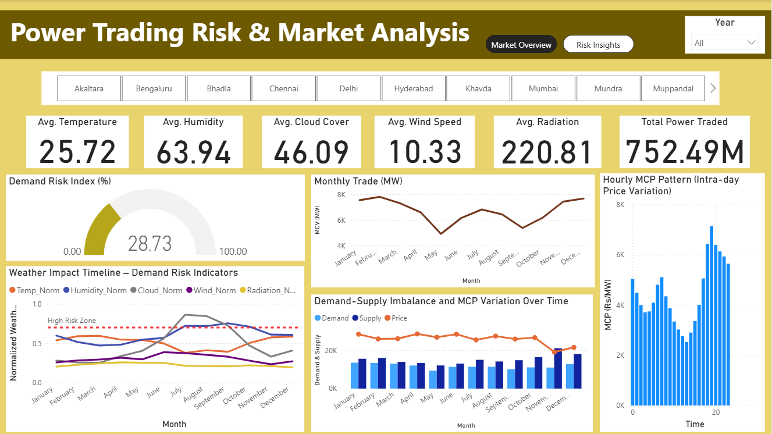
Data Visualization
Notes:
Add graphical

Slide 12
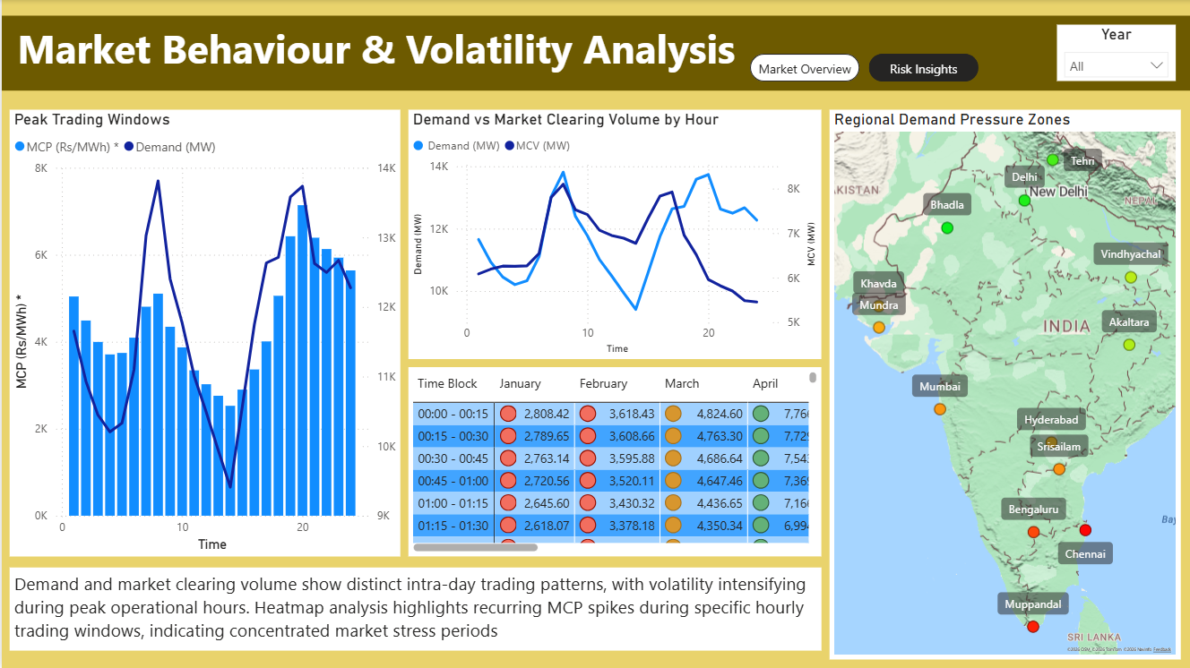
Data Visualization
Notes:
Add graphical

Slide 13


